Slide 1
WILDFIRES
An interactive Wildfire dashboard created by:
Ranjani, Novak, Saiana, David

Slide 2
Background about Wildfires
As of September 14, 2021, the National Interagency Fire Center (NIFC) reported that 44,647 wildfires in the United States had burned 5.6 million acres of land
We wanted to create an engaging and informative visualization of all wildfires that occurred in various states of USA in 2021, and other relevant data (county, month, and acres burned etc.)

Slide 3
Extraction of Data
The data was retrieved from National Interagency Fire Center’s website in a csv format, which has current and very detailed description of all wildfires in the country
The csv file contained over 4000 rows and more then 100 columns of wildfire from 2021 alone

Slide 4
Transformation of Data
Basic steps followed for transformation:
•Unnecessary columns were deleted, and we renamed existing columns
•Wildfires with null longitude and latitude were removed and null values in the cause column were changed to “cause not found”
•Country-State column was split into two for further analysis
•Fire Duration column was added by subtracting the end date with the beginning date
•A html table file was created and exported for use on a webpage
•After cleaning up the data, the csv was converted to a geojson file

Slide 5
Loading of Data
• Loaded the data in relational database Postgres
• Imported SQLalchemy dependency in the Jupyter Notebook, an engine was created that connected to the pgAdmin Data Base, called wildfire_db
•With pandas, the data frame was exported and stored in the wildfire_db data base

Slide 6
Deployment of Data
CSS,Bootstrap and Javascript are used to style the webpages
Used additional library elevator.js for scrolling purpose of the app
A flask app.py file was produced as a micro web framework to deploy the web application
Deployed our Wildfire app in both Heroku and GitHub servers

Slide 7
Charts and Analysis
Data was analyzed in the Jupyter Notebook by looking at acres burned, locations, fire causes and fire durations
Visualizations using Jupyter were created utilizing Matplotlib, Folium and Seaborn dependencies

Slide 8
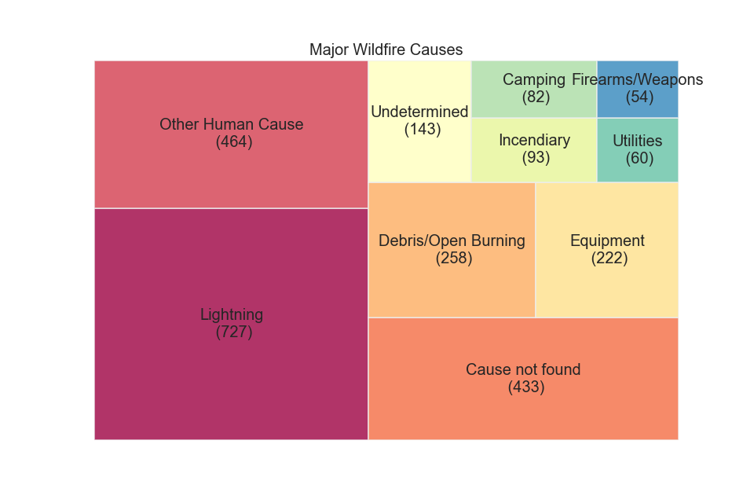
Top Causes of Wildfires
Tree Map using squarify library showcases that top causes of wildfires was lighting
For a majority of it, the cause of the fire is Lightning

Slide 9
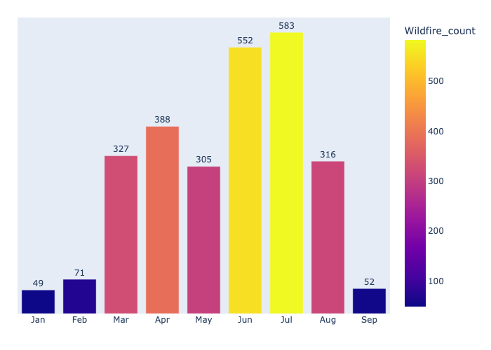
Wildfires by Month
Looking at the data grouped by month, we can clearly see that the number of wildfires in winter is relatively low and that it is significantly high in summer, especially in June and July

Slide 10
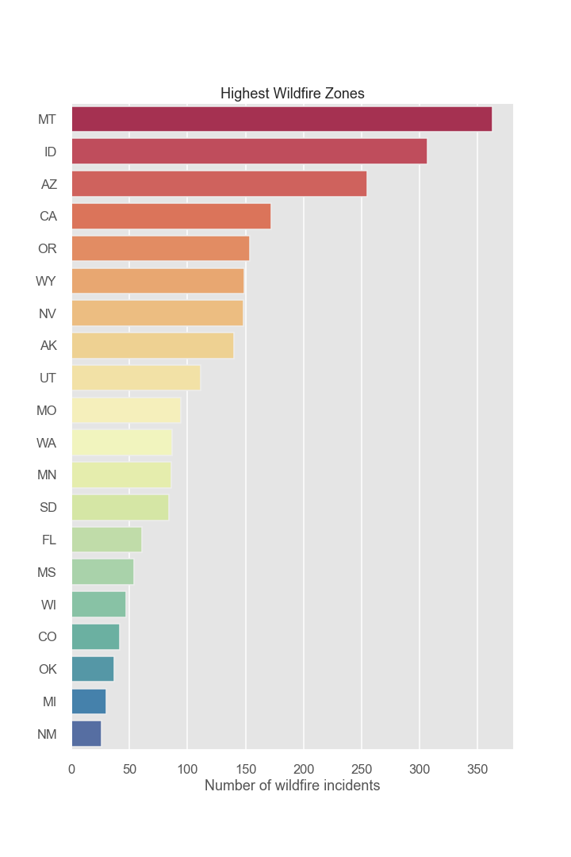
Wildfires by State
Grouping by state, it can be concluded that majority of wildfire incidents happen in a couple of states, with Montana, Idaho, and Arizona being on the top of the list
Surprisingly, California comes in fourth, with Montana having more than twice the amount of incidents

Slide 11
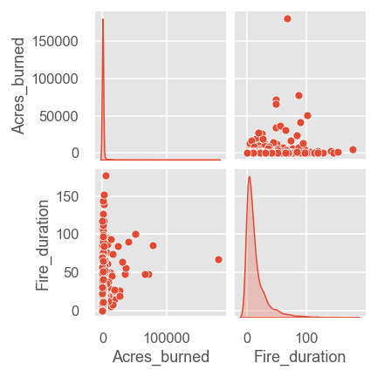
Fire Duration vs Acres Burned
Wildfires burned more acres the longer the duration of the fire in the beginning stage of the fire. Most of the fires, after around 20 days, were subdued and under control with only a handful still increasing in the size of acres burned
After 100 days, all fires in our dataset were under control with minimal burning

Slide 12
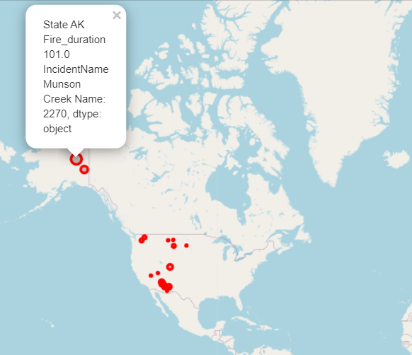
Folium Map for Fire Duration
Plotted folium map for the states with highest duration of wildfire
Bigger the circle, longer the duration
Each marker provides information such as Incident name, duration, state and county.

Slide 13
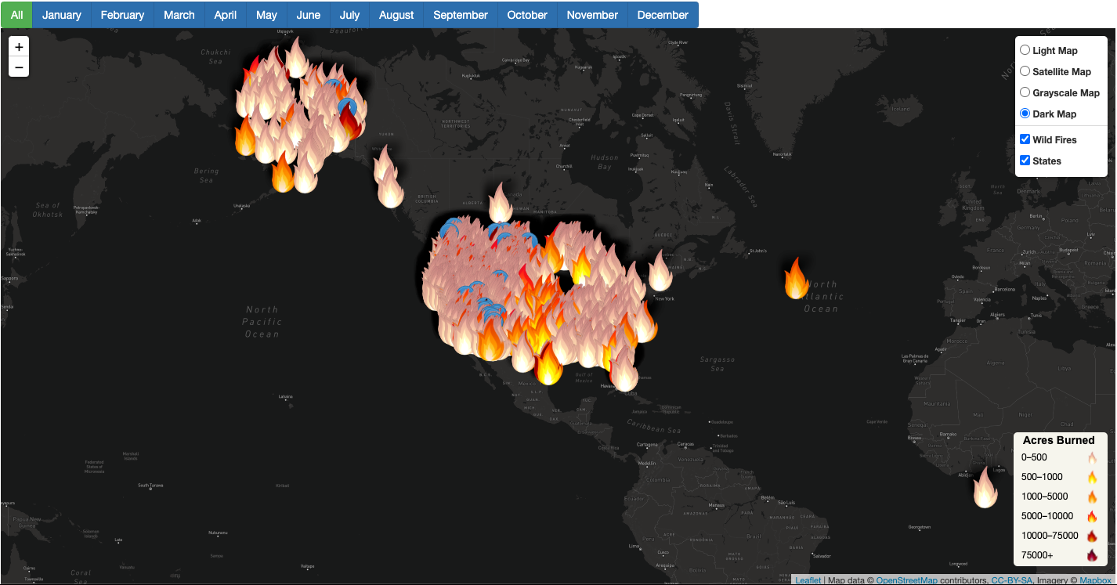
Interactive Map
Reading the geojson file via Java Script, an interactive map with all the wildfires and its data was created
This interactive map can be filtered by month and there are 4 different base maps
Flame icons are darker based on acres burnt and each flame has information on the wildfire such as acres burned, county, state, and an incident description
Map Visualization was created with LEAFLET, PLOTLY, and D3.js libraries in JavaScript

Slide 14
Conclusion
By looking at the data, we can conclude that wildfires have been increasing over the years in number, as well as being larger in size and intensity
A handful of states have most of the wildfires with Montana and Idaho being on top of the list
Human causes, fire sizes, and times can be reviewed in order to prevent future wildfires in the problematic areas

